Slide 1
OnPoint Consultancy
IST-687
~Taking Your Business Personally.
Urvi Mistry
Ritika Shetty
Harsh Mehta
Harsh Darji

Slide 2

Taking Your Business Personally.
Agenda
Style
01
Introduction
Briefing the audience about the problem that is faced and introducing the dataset that is used to counter the problem.
02
Business Questions
Framing the questions that will help to understand the problem in a better way and eventually solve it.
03
Descriptive Statistics and Visualization
Supporting statistics and visualizations to our business questions.
04
Modeling Techniques
Various Models to interpret the parameters on which our business questions rely upon.
Enabling the audience to make a profitable decision.
05
Interpretations
Deriving actionable insights from the models used.

Slide 3
Introduction

Slide 4




Introduction
Objective
We as a consultancy firm are focusing on solving business problem for Southeast Airlines. We have a survey of 14 different airlines which would be used as a comparison set to check the parameters where Southeast Airlines is performing poor. The main goal is to identify parameters that causes dissatisfaction among the customers
of Southeast Airlines and generate actionable insights that will help the customers of Southeast Airlines to be happy and eventually help Southeast Airlines to raise profits.

Slide 5
Data
Key to understand
SATISFACTION
Delay in Arrival
Delay in Departure
Flight Time
Flight Distance
Arrival delay greater than 5 minutes
Date
Origin city
Destination City
Airline Status
Schedule Departure Hour
Class
Percent of flights with other airlines
Day of month
Flights per annum
Loyalty Cards
Shopping amount
Eat/drink amount
Age
Gender
Price Sensitivity
Year of first Flight
Type of Travel
Person Attributes
Travel Attributes
How the flight went

Slide 6
Business Questions

Slide 7

Business Questions
How does the delay in flight by more than 5 minutes affects the ratings?
Does type of travel, loyalty cards and price sensitivity have an impact on ratings by customer?
Do particular city or state causes dissatisfaction?
Does delay in arrival and delay of flights causes dissatisfaction?.
Does date of travel and day of month affects customer satisfaction
How does age and gender affects satisfaction and are the significant for Southeast and Other Airlines?.
Is it possible to associate no of flights taken, flight distance and flight time to ratings given by customer?
Are the customers of Southeast Airlines satisfied as compared to other Airlines.?
How much does shopping and drinking at airport causes variation in rating given by customer?

Slide 8
Descriptive Statistics & Visualizations

Slide 9
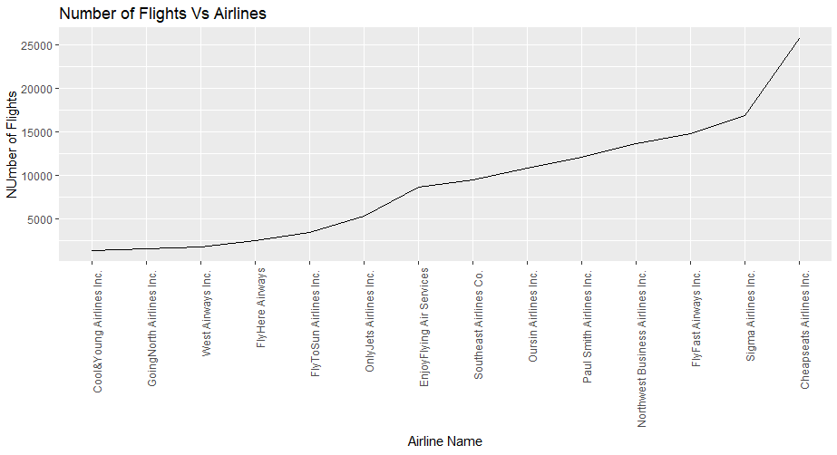

Slide 10
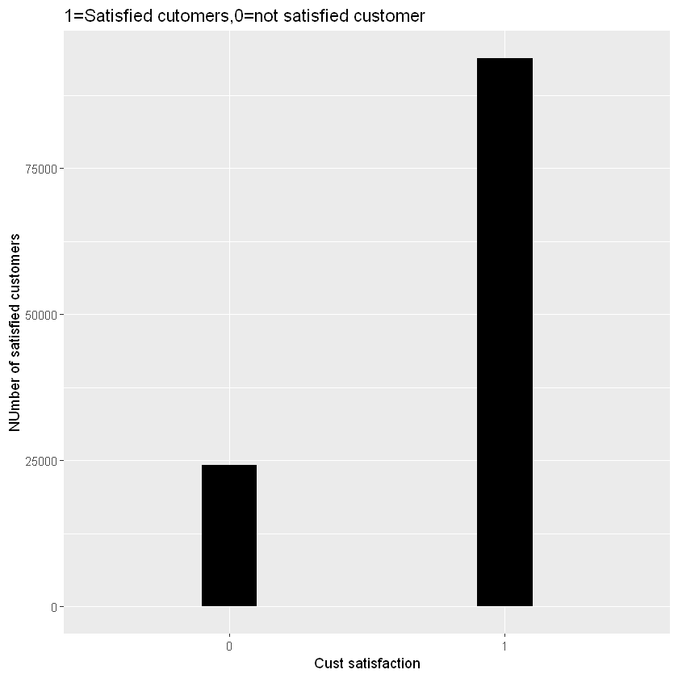
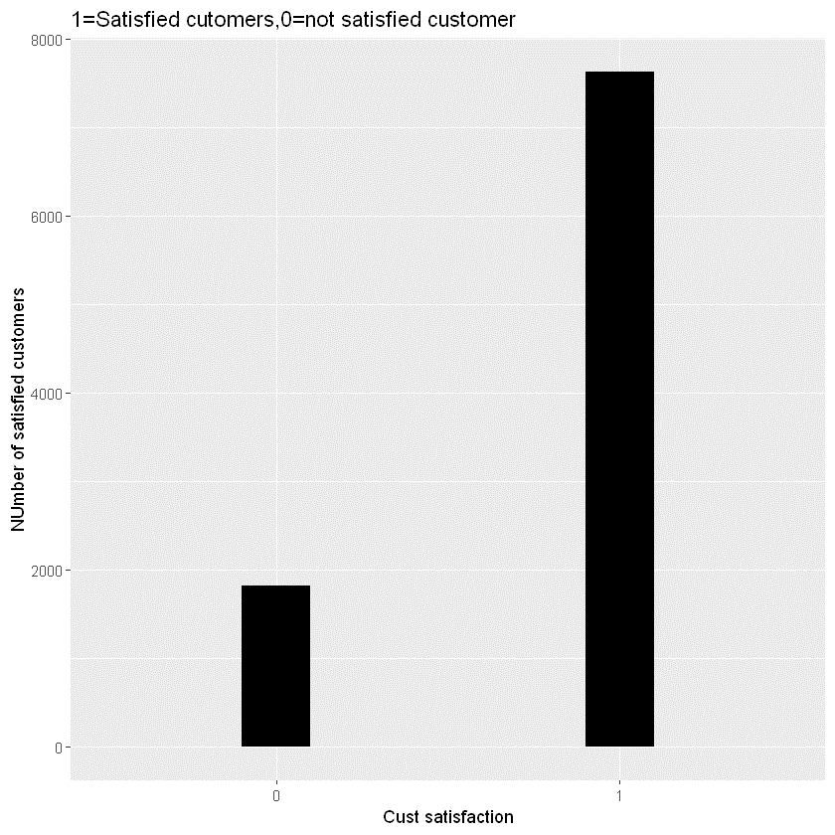
Are the customers of Southeast Airlines satisfied as compared to other Airlines?
Other Airlines
Southeast Airlines

Slide 11
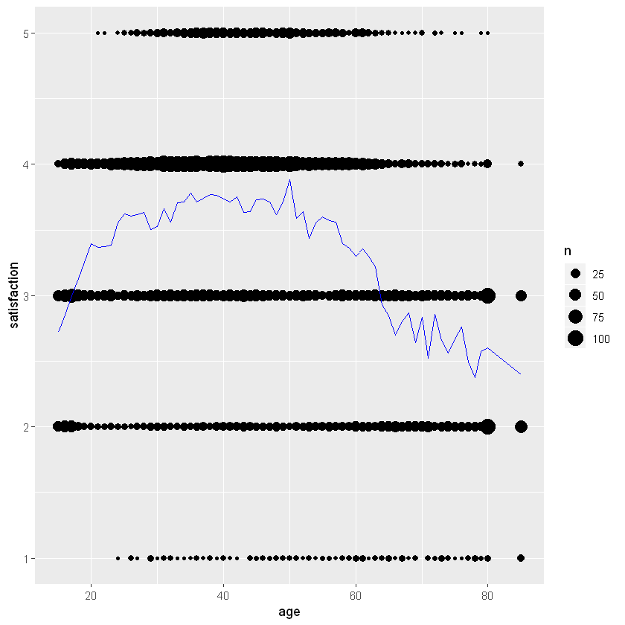
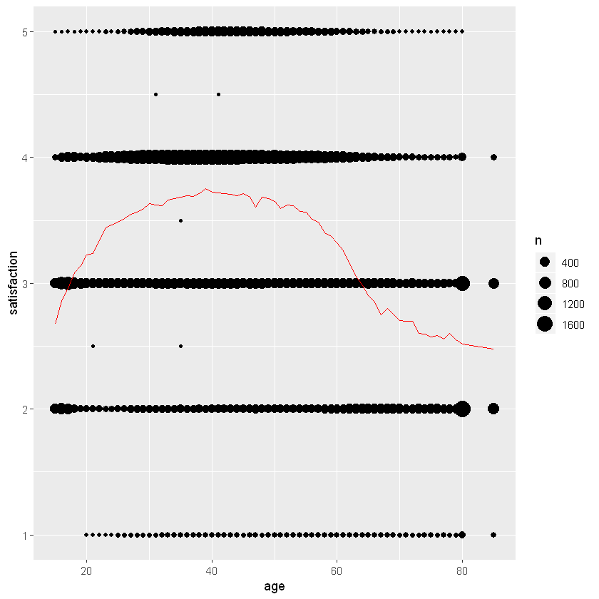
How does age and gender affects satisfaction and are the significant for Southeast and Other Airlines?.
70%
80%

Slide 12
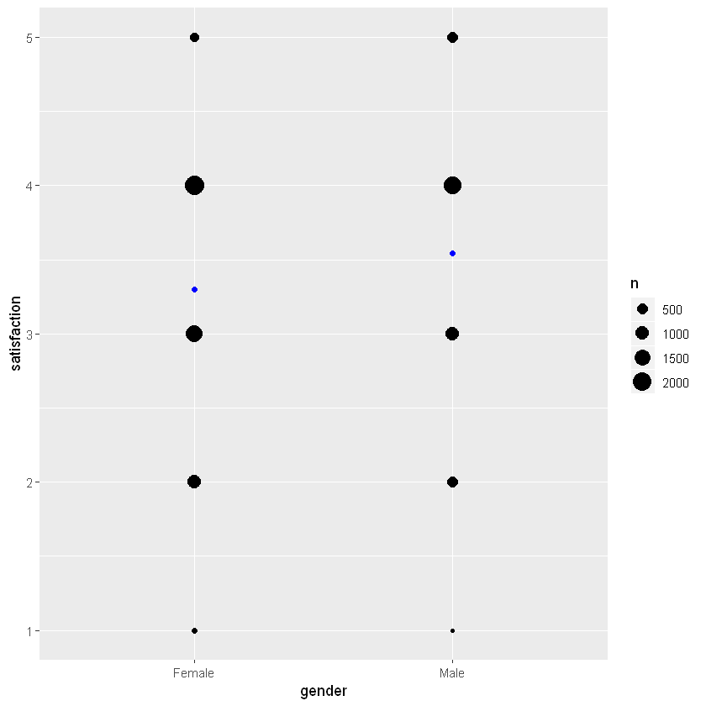
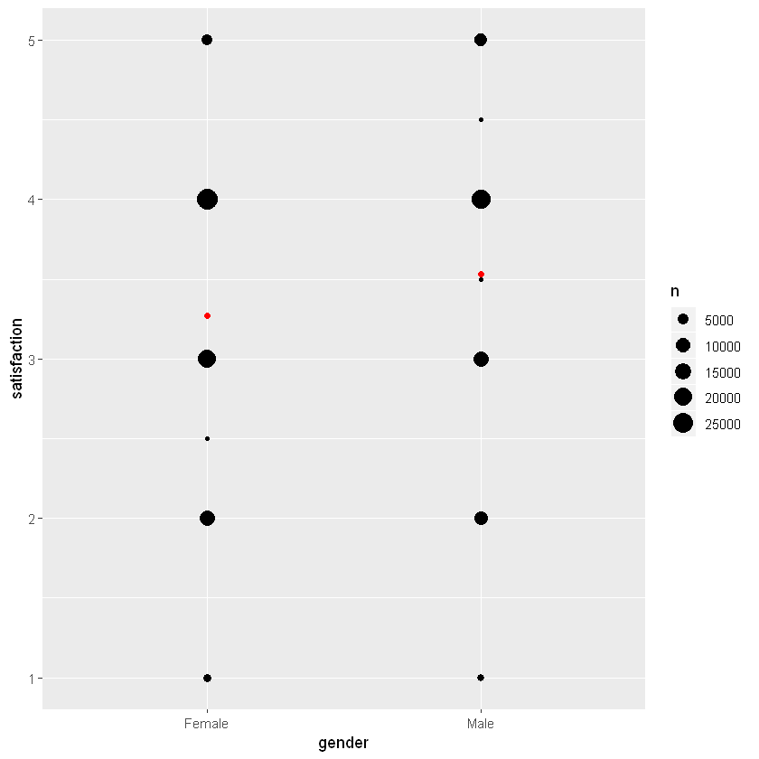
How does age and gender affects satisfaction and are the significant for Southeast and Other Airlines?.
70%
80%

Slide 13
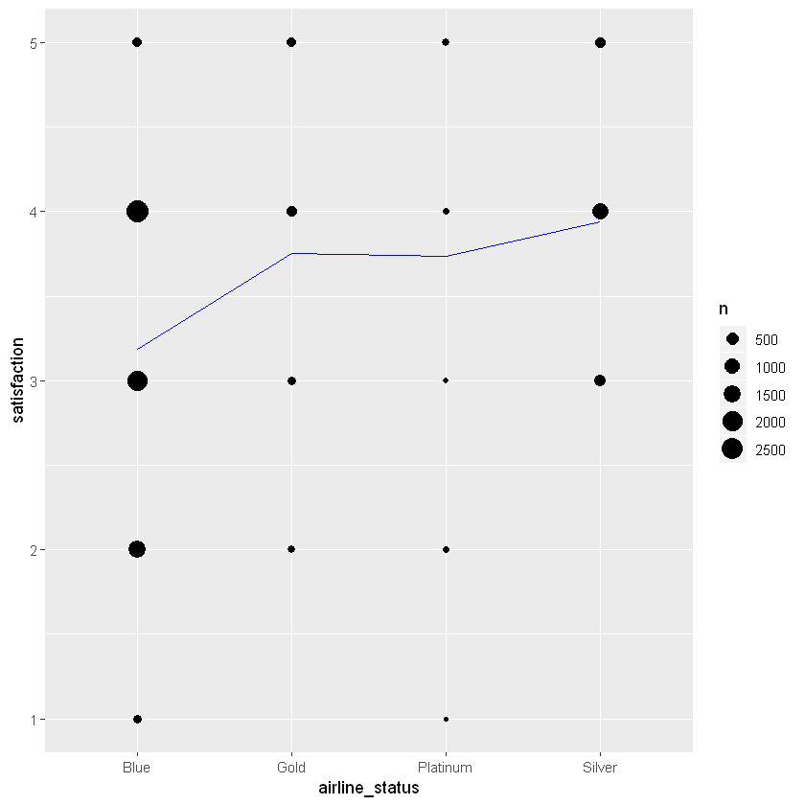
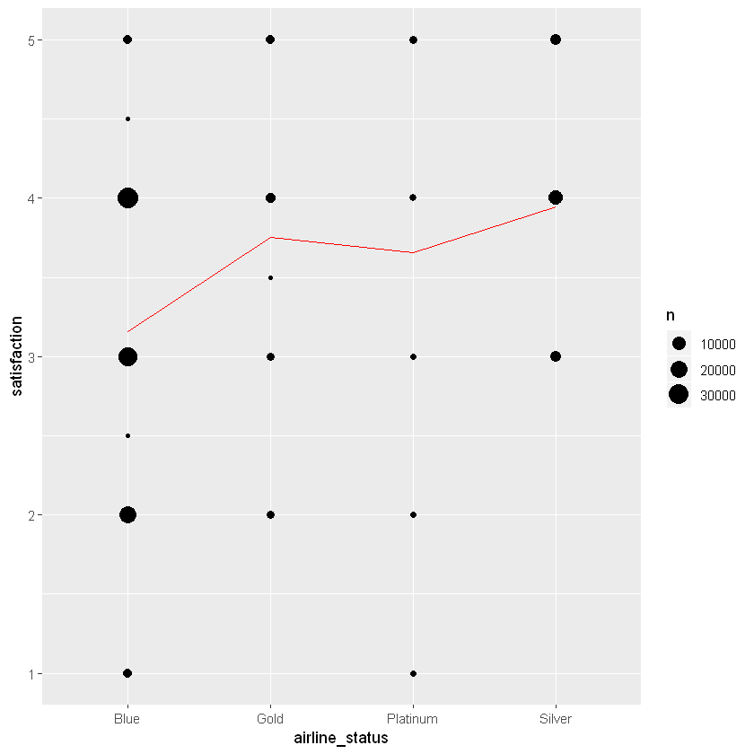
Does airline status affects customer satisfaction?

Slide 14
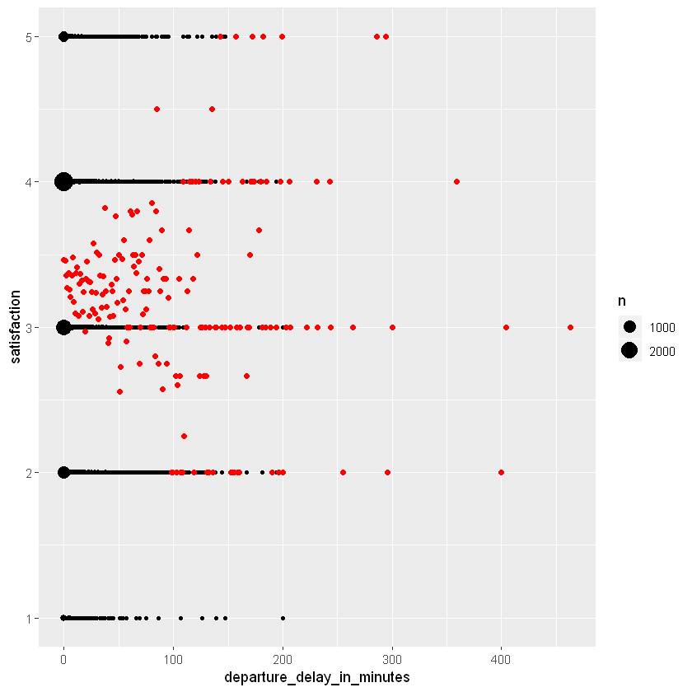
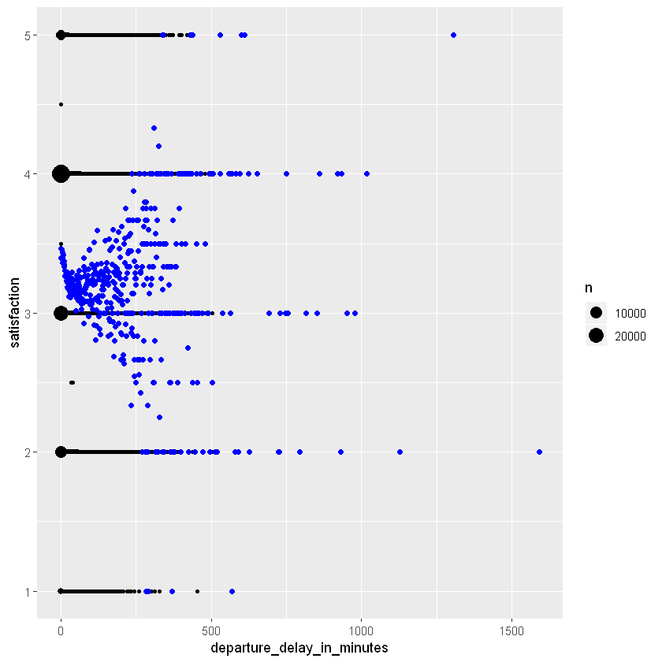
Modern PowerPoint Presentation
Graphic Infographic Designed
Does delay in arrival and delay of flights causes dissatisfaction?.

Slide 15
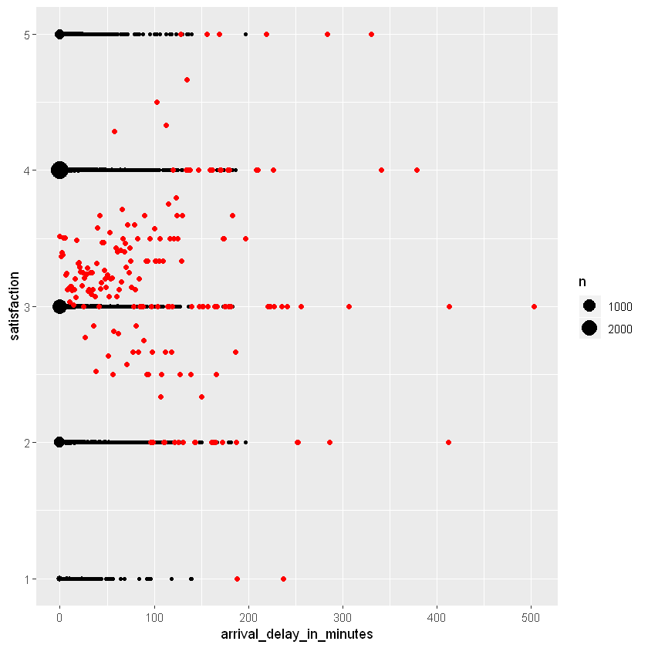

Modern PowerPoint Presentation
Graphic Infographic Designed
Does delay in arrival and delay of flights causes dissatisfaction?.

Slide 16
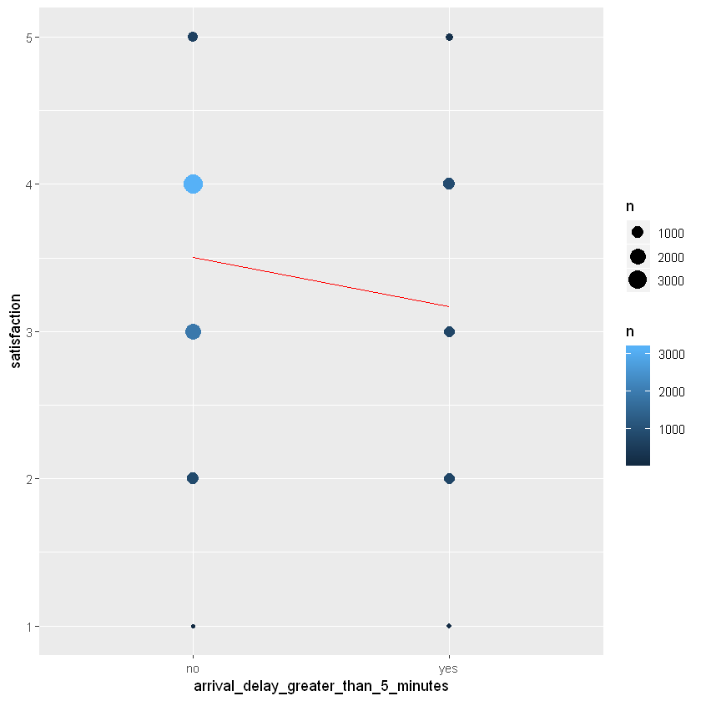
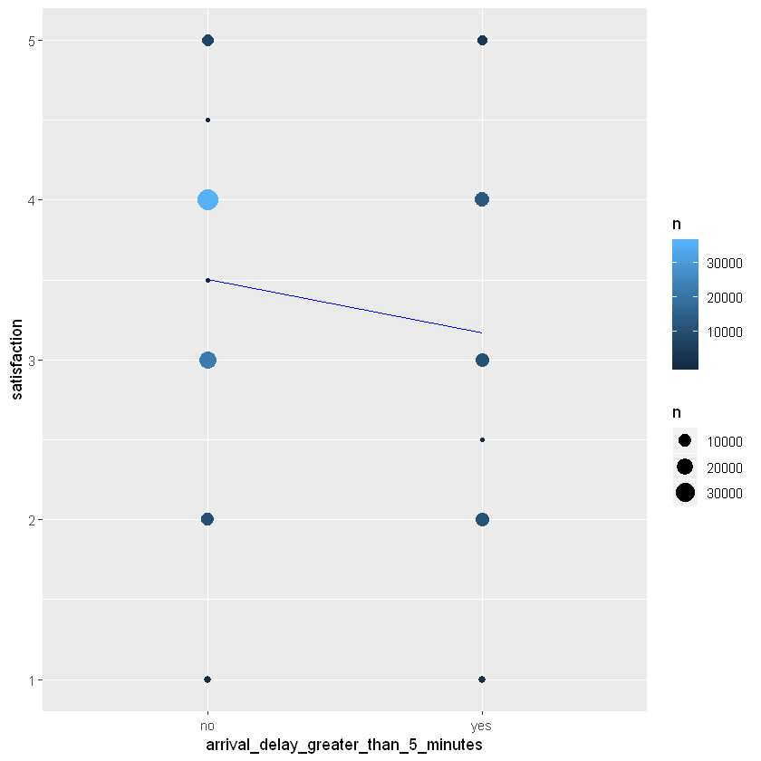
How does the delay in flight by more than 5 minutes affects the ratings?

Slide 17
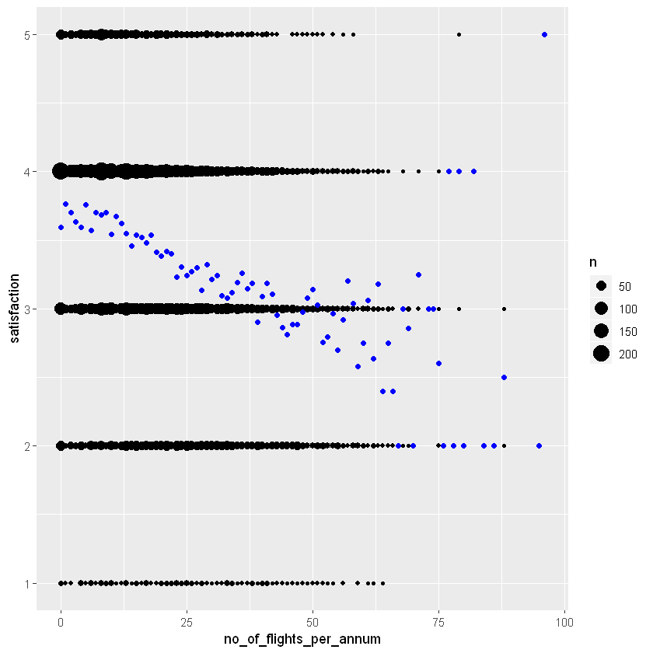
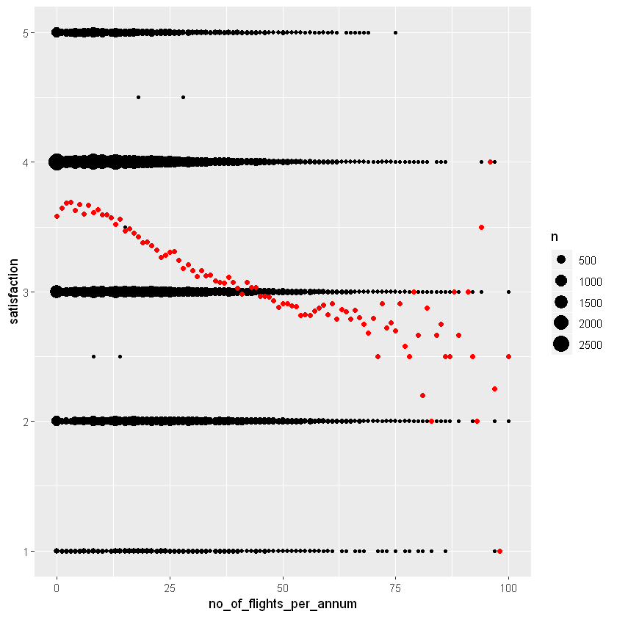
Is it possible to associate no of flights taken, flight distance and flight time to ratings given by customer?

Slide 18
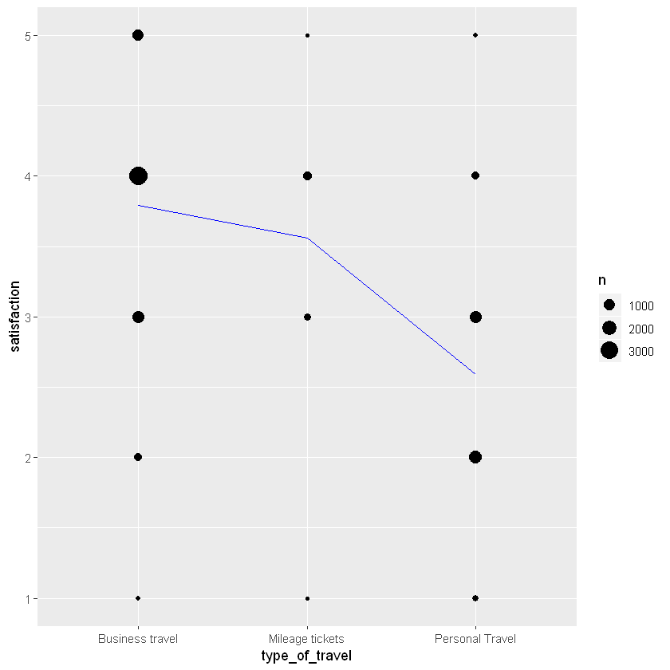
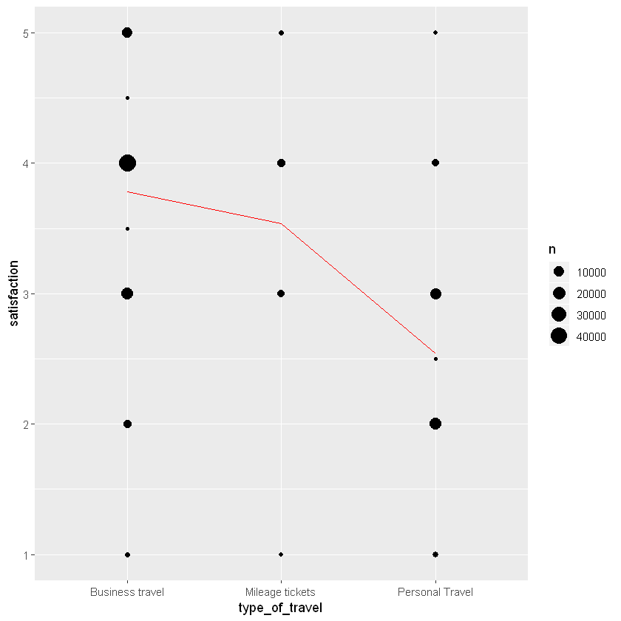
Does type of travel, loyalty cards and price sensitivity have an impact on ratings by customer?

Slide 19
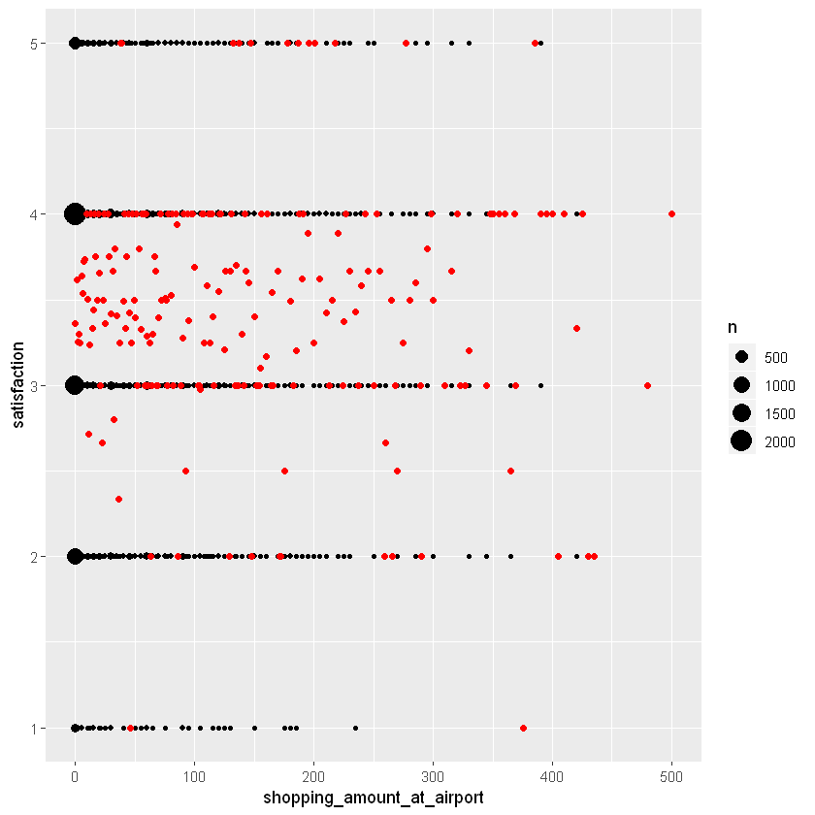
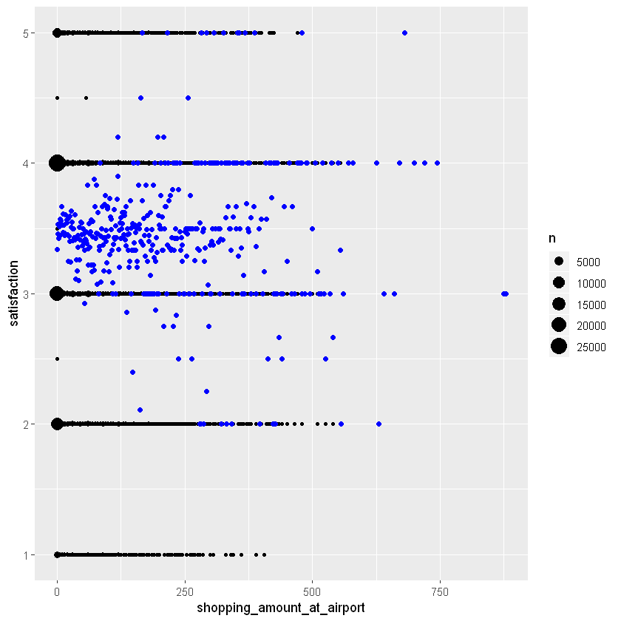
How much does shopping and drinking at airport causes variation in rating given by customer?

Slide 20
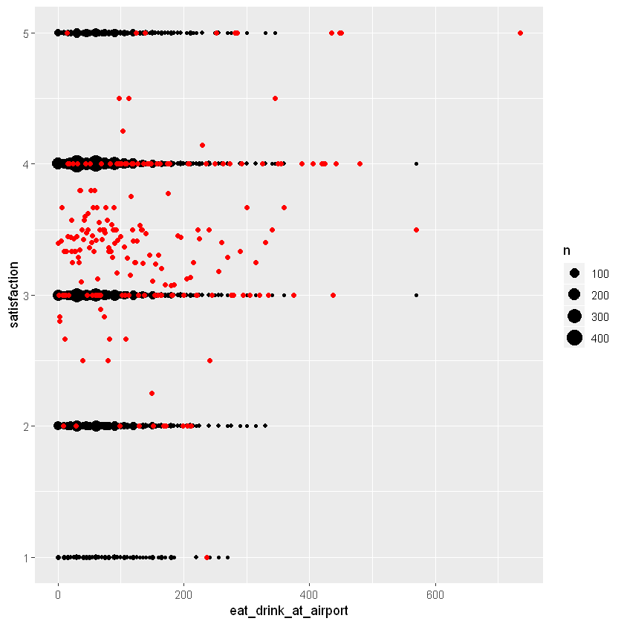
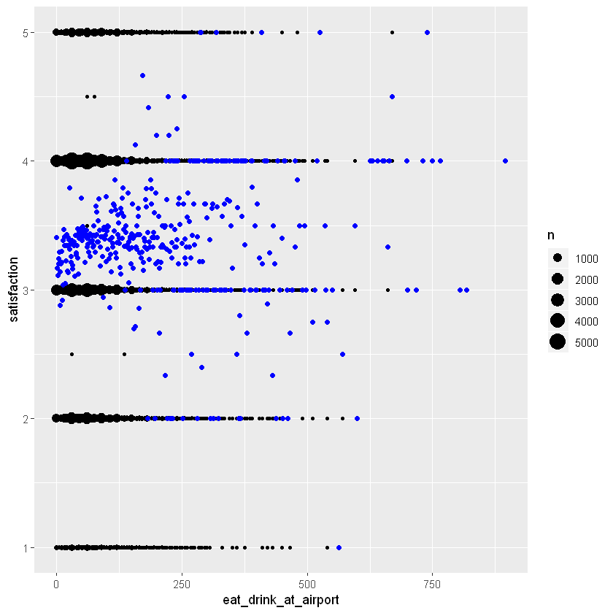
How much does shopping and drinking at airport causes variation in rating given by customer?

Slide 21
Modeling Techniques

Slide 22
Modeling Techniques
Regression
Logistic Regression
Apriori (Association Rules)
Svm
Applied linear regression model on the entire dataset and found that attributes Type of travel, Airline status, Number of flights per annum and Arrival delay greater than 5 minutes are the most significant attributes i.e. they are affecting the Satisfaction of the customers.
Ran a Logistic regression Model and found out the significant value. Calculated Accuracy using area under the curve method.
Applied Apriori algorithm and association rules on the entire dataset as well as on the Southeast Airlines Co.’s dataset and determined combination of attributes that have highest lift value.
Using svm modeling technique (linear regression and classifier) to find out significance and predicting ability

Slide 23
Modeling Techniques
Linear Regression
Airline Status
Type of Travel
Arrival delay greater than 5 minutes

Slide 24
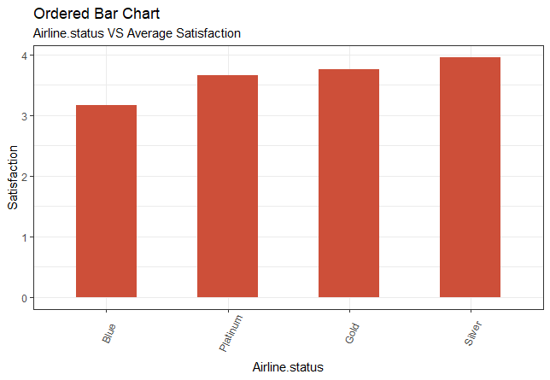

Slide 25
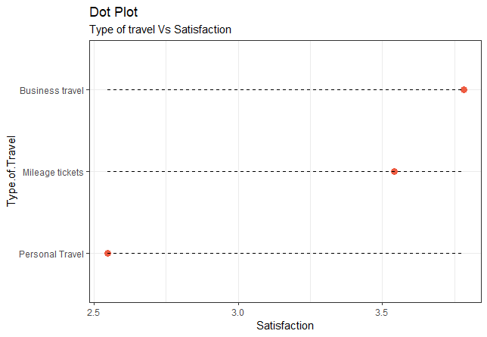

Slide 26
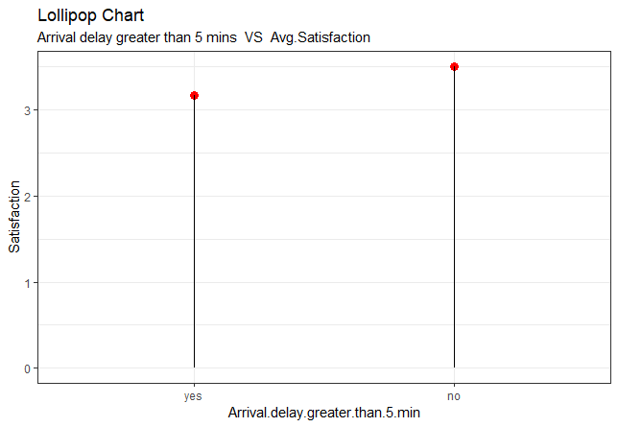

Slide 27
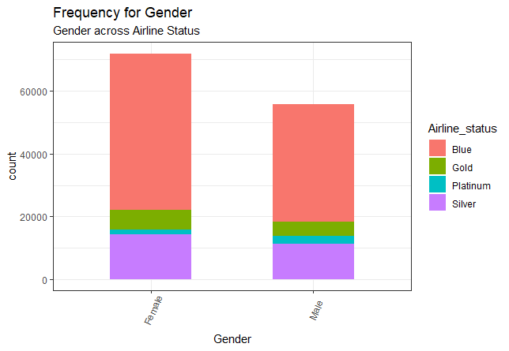

Slide 28
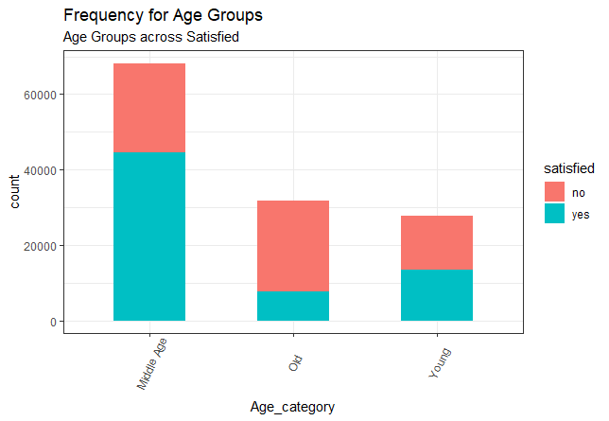

Slide 29
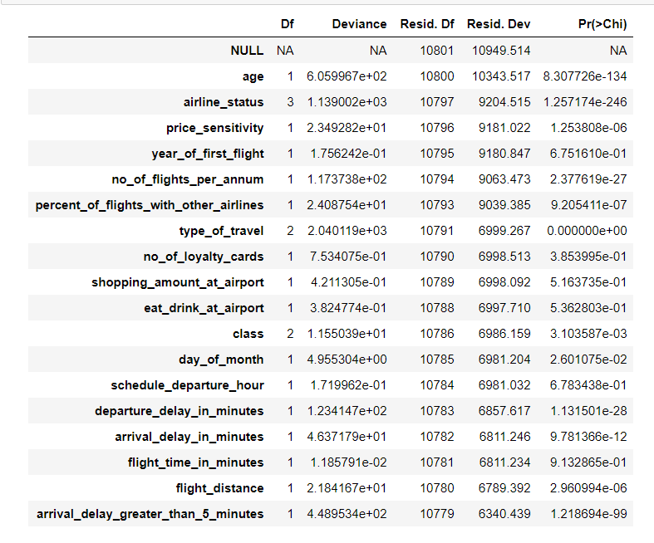
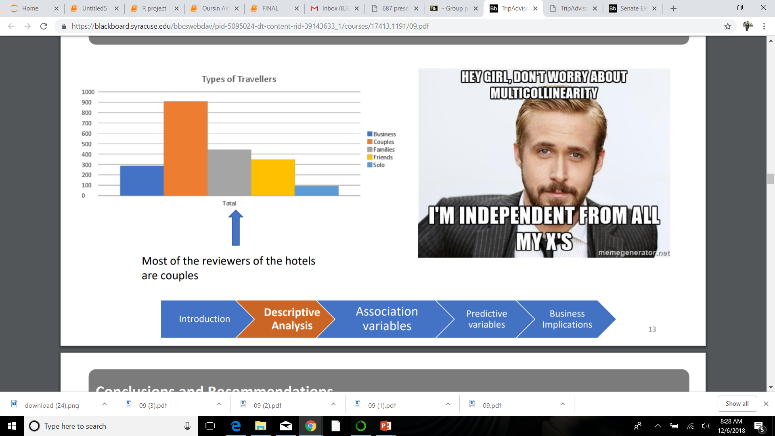
Modeling Techniques
Logistic Regression

Slide 30
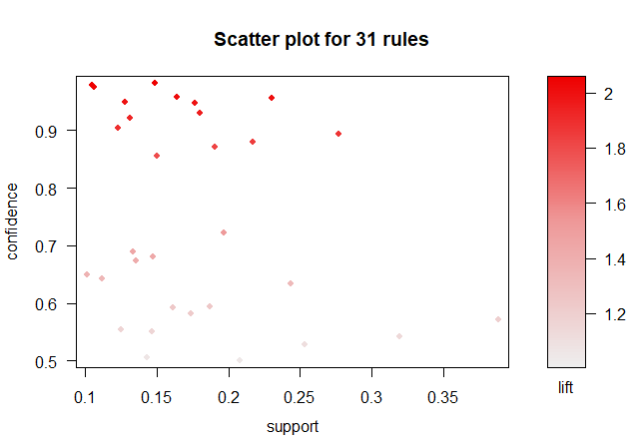
Modeling Techniques
Apriori (Association rules)
{Age=High, percentflightwithotherAirlines=less than 10, Departuredelay=low, Arrivaldelay=low, FlightDist=less, cleanData.Airline_status=Blue, cleanData.Type_of_travel=Personal Travel} => {satisfied=no}

Slide 31
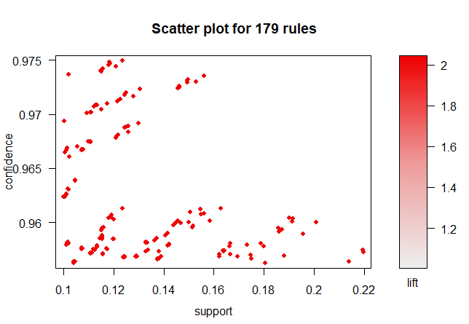
Modeling Techniques
Apriori (Association rules)
{pricesensitivity=low,
Departuredelay=low,
Arrivaldelay=low,
cleanData.Airline_status=Blue,
cleanData.Gender=Female,
cleanData.Type_of_travel=Personal Travel}
{pricesensitivity=low, cleanData.Airline_status=Blue, cleanData.Gender=Female, cleanData.Type_of_travel=Personal Travel, cleanData.Class=Eco}

Slide 32
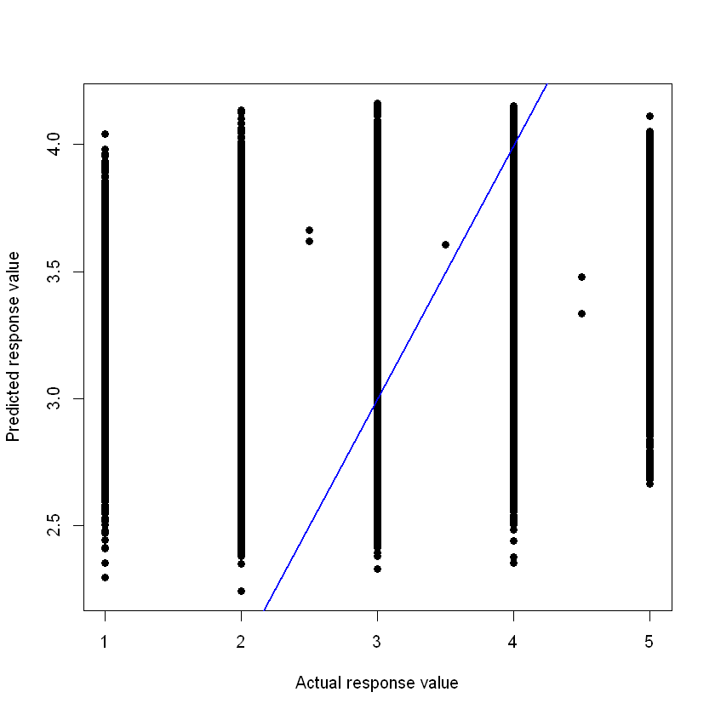
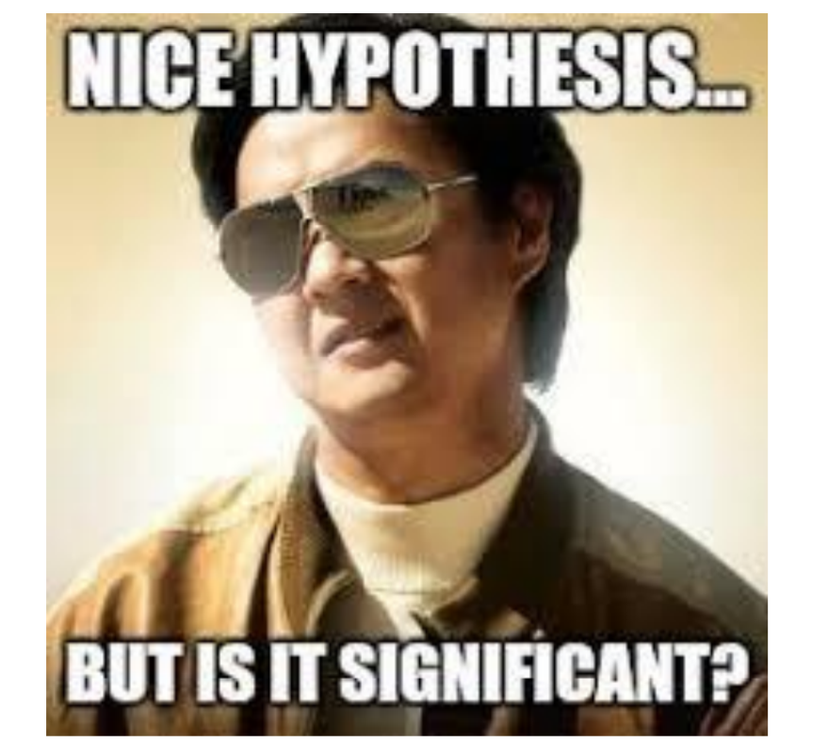
Modeling Techniques

Slide 33
Interpretations

Slide 34
Interpretations
Satisfaction tend to reduce as arrival delay increases
Satisfaction reduces by around 0.5 If the arrival delay is greater than 5 mins for South east and other airlines.
Departure delay affects the Satisfaction rating by a small amount. There is evidence that the satisfaction reduces as departure delay increases, but this is not true for all cases.
Age affects satisfaction in both southeast and other airlines. Age 20 to 50 -> increases. From 50 -> starts decreasing
For Southeast airlines, satisfaction tends to increase as the no. of flights p.a. decrease.
Customers who shop between 600-800 give a high customer satisfaction rating for other airlines whereas those who shop for 500-600 give a high customer rating for southeast airlines
When customer’s travel for personal reasons, their satisfaction is the lowest (around 2.5)
In both Southeast Airlines and other airlines, customer’s travelling by blue status have the lowest satisfaction rating, followed by Platinum.

